Slide 1
Software Engineering and Architecture
The Exam

Slide 2
Exam guide
Release Nov 2023!
Feedback is very welcome
On the last week plan
Best: Rehearse during TA classes !
Many of you have already done so!

Slide 3
When
A few before Christmas, the rest in January
Censors:
Magnus Madsen,
Clemens Klokmose,
Niels Olof Bouvin
The examination plan is on BrightSpace
The faculty one is out-of-date!

Slide 4
Dispensations
Important about those applying for dispensation
(Requesting the preparation time to be extended)
Apply early!!! (= NOW!!!)
Reason:
Due to logistics, all students with a dispensation are grouped into one or two examination days
Thus it is vital that we know the number early to make usable planning of the examination days!!!
Days for ordinary exams will proceed with ~30-35 min slots!

Slide 5
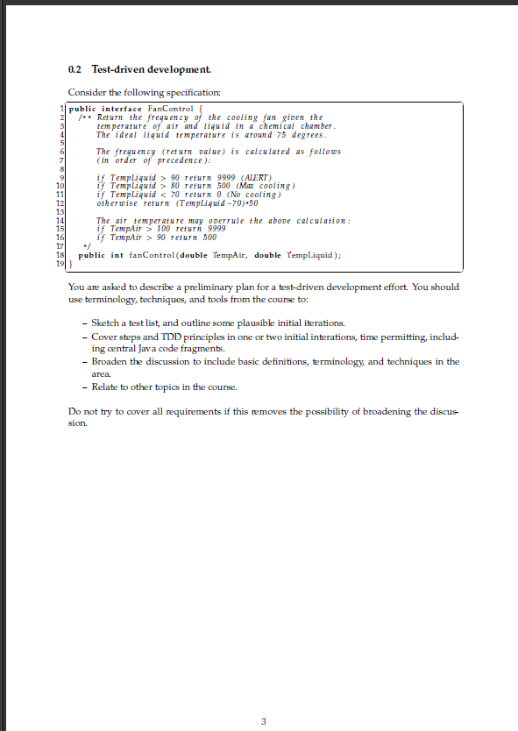
The Plan
Examination format: Physical + Zoom based
Physical
You get you exam exercise on paper.
The exam is physical in the sense
In the same room with me and censor
We talk ☺
Zoom based
You present your solution produced during the preparation time using Zoom shared screen
Code stuff in particular…
And of course the whiteboard if you wish

Slide 6
How
Be in the waiting room of exam Zoom session
Best before your exam actually starts ☺
Have your study id card ready for verification
Draw a random exercise
The exercise is a single A4 physical piece of paper
Read, understand, and ‘start solution’
I do not expect a complete and polished solution!
Better to understand the exercise than show a solution to something else than the exercise
Not a disaster, but it takes valuable time out of the examination

Slide 7
The Exam Exercise
It should be obvious, but still...
Any form of copying and distribution of an exam exercise is exam cheating. Exam exercises are secrets.
Any instances of copies on any platform should be reported to me!
After exam, you must delete produced material.

Slide 8
How: The Preparation
During the preparation period (30 – 35 min)
Use your own laptop to overall ‘solve’ (parts of) the exercise
Prepare a UML diagram
Prepare a EC and test case table
Prepare code skeleton / partial solution
To be presented at the exam…
Resources available: “Everything” except any help from 3rd party
No help from other persons or ChatGPT, or other AI tools

Slide 9
The Exam
We sit together – we talk and discuss
Censor, I and you are on Zoom and you share your screen
Present your developed code/material and talk us through what you have made – and we ask questions etc.
11-12 minutes only
‘but … I only have started’

Slide 10
After Exam
After the exam we will
Of course give you a grade, explain the reasoning behind it, and provide advice wrt. future exams
Require you to delete produced material
As any distribution of your developed material and the exercise itself is considered exam cheating.

Slide 11
Grading
Starting E2022 the mandatory points are not counting towards the final grade…
Mandatory point 60% of 430 = 258
Handin of all 10 exercises
Is required to attend the exam
Final grade is based upon oral exam only.

Slide 12
Some Stuff You May Meet

Slide 13
Realistic Exam Exercises
All exam exercises are modelled after realistic systems!
No exercises ala
Use Broker to implement objectFoo.doSomething(27,”Fisk”);
Which means you will run into Java classes like
ZonedDateTime
PrintStream
And code inspired by HotStone, MiniDraw, TeleMed, PayStation…

Slide 14
Realistic Exam Exercises
All exam exercises are modelled after realistic systems!
… which means it will contain realistic terms from IT and domain
I expect you to know what terms like
GPS, Mobile phone, app, SMS/Text message, database, caching, server, blood pressure, inventory,
… means
Often terms are explained or written in Danish
Tenant (Da: “lejer af lejlighed”)
Caching (That is, store a local copy of data so a remote fetch is not required)

Slide 15
Hints and Advice

Slide 16
Format
Use the provided exam question set to rehearse the exam format
Pick an exercise from the example set
Spend 20-25 minutes
Finding solution techniques
Partially solving it using your laptop with appropriate tools
Spend 12 minutes doing a ‘dry-run’ exam with your group
Let your other groups members act examiner
Rotate and repeat ☺

Slide 17
Solve the Exercise
SWEA is not just defining three interfaces with a method in each…
I see a lot of ‘solutions’ at the exam of this type
Where are they used? Where are those methods called? By Whom?
Ala ‘theObject.doSomething(….)’

Slide 18
Appropriate Tools
Experience from last year’s Zoom based exams
Word is not a good editor for code !!! !!! !!!
Free-hand drawing on a laptop does not work!
A mouse is not a pen. Pen = fine muscles; mouse = coarse…
Use IntelliJ?
Be sure you have tried it out before you do. Do not let it spoil the exam because it insists your code does not compile

Slide 19
Appropriate Tools
Find a good code editor that is not an IDE
Gedit, Emacs, SublimeText, EditPlus, Nodepad++, etc.
It does not choke on pseudo code but knows indentation, syntax highlight etc.
Find a good spreadsheet type program
For making EC tables and test case tables
Filling out the Clean code analysis
Find a decent way of drawing UML
An editor – or – draw it on the whiteboard at exam

Slide 20
Test the Technique
Zoom Share Screen is essential and must be tested
Mac’s require a setting to be changed and the machine rebooted
Ok, so the first 4 minutes of your exam is spent on that
Bad grade due to not testing that aspect in advance?
Screen sharing does not work on certain Ubuntu versions!
Bad grade due to not testing that aspect in advance?

Slide 21
And…
Increase the font size! ☺

Slide 22
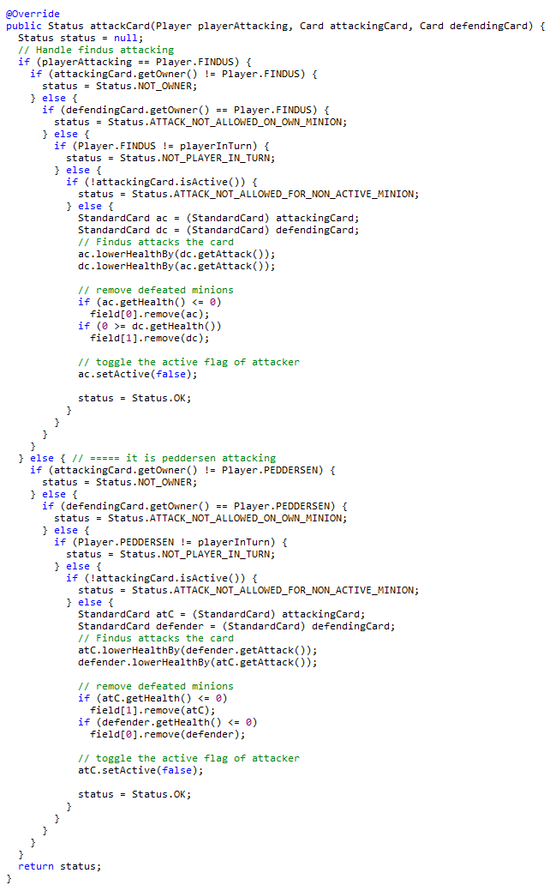
Right?
As you can obviously see in line 17, I have coded the State pattern
(No, I cannot)

Slide 23
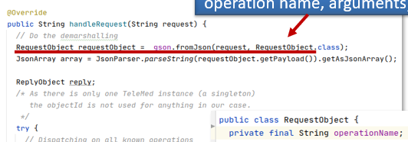
Templating
At the exam you are only allowed to bring whatever you produce in the preparation.
The exception to this rule
The Invoker code base involves boilerplate code that is the same always (demarshalling ‘request’ into its request object)
It is OK to copy that from a template you prepare in advance…

Slide 24
Nervous?
Some students are not nervous at exams.
How do you do that???
Some are...
Learn to use your nervousness, instead of trying to avoid it...
Perhaps it is not a problem, it is a condition of life…
Problems you solve, conditions you learn to live with…

Slide 25
Paths to Failure
Common failing reasons

Slide 26
Observations
Commonalities in failing the SWEA exam
Level 1
Coding mastery
Level 2
Shallow learning / ”parrot knowledge”
Reading a specification causes problems
A few in the classic category: read the book also…

Slide 27
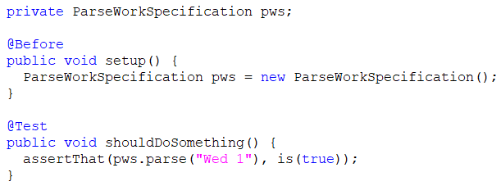
Coding
Too many do not fail SWEA, but fail to have sufficient coding practice at my exam
Writing ‘nonsense’ and cannot see the problem
What is a constructor?

Slide 28
Parroting 1
”Parrot” knowledge
You can learn the visual appearance of Strategy pattern UML
You can learn the visual appearance of Strategy code template
You can learn the common names used in Strategy
Without any clue of what Strategy is
Beware of it!

Slide 29
Pattern Matching
Similar – ”pattern matching” shallow learning
Make ECs correctly for an interval in the exercise
But fail to mention what heuristics that has been used (range)
Fail to know how the range heuristics is formulated
Fail to know what an EC is at all
Make ‘ECs’ that are test cases
7 [b1]
Conclusion
Learned the ”template”, then put arbitrary stuff into it ☹

Slide 30
Exercise Reading
You will have to read the exercise and understand at least a bit of it
Read the code fragments / interfaces – they are the key question

Slide 31
And of course the usual
A few fail of the same reason as in other courses
Have we read the same book and coded the same exercises???

Slide 32
Conclusion
You have to master some of this course to pass it
You need some level of mastery of Java or OO language
Which you learn by doing it
You need to understand what is behind the templates
Which you learn by doing it
You need to be able to read a small specification
Which you do by reading it

Slide 33
SWEA 2023 signing off…
It has been a pleasure flying with you

